Slide 1
CSS Styles (WIP)
CS/IT 490 WD, Fall 2013

Slide 2
Breakdown
Style Notes
Colors
Text
Dimensions
Layout
Miscellaneous

Slide 3
Style Notes
As we go through different styles, you'll notice that some styles can be broken up or shoved together.
For example, you could specify a background image and background color with the “background:” style, or specify them separately with “background-image” and “background-color”

Slide 4
Background
Properties of a Background:
  Image
  Position
  Repeating
  Size
  Color

Slide 5
Background
.myItem { background-image: url( “path” ); }
Specify a path to a background image, relative to the .css file.
http://www.w3schools.com/cssref/

Slide 6
Background
.myItem { background-position: center center; }
The position can contain (x,y) coordinates as units, x% y% shifted, or simple values like “left top”, “center center”, “right bottom”.
http://www.w3schools.com/cssref/

Slide 7
Background
.myItem { background-position: 20px 40px; }
(X,Y) Coordinates:
This can be in pixels (px)
This can be in em (unit of font size)
This can be % of the page
This can be inches/centimeters (in, cm)
http://www.w3schools.com/cssref/

Slide 8
Background
.myItem { background-position: left top; }
If you use the shortcut positions:
Horizontally, you can have:
  left, center, right
Vertically, you can have:
  top, center, bottom
http://www.w3schools.com/cssref/

Slide 9
Background
.myItem { background-repeat: no-repeat; }
Whether or not a background image repeats. You can set this to:
repeat (both directions)
repeat-x (repeat horizontally only)
repeat-y (repeat vertically only)
no-repeat (no repeating)
http://www.w3schools.com/cssref/

Slide 10
Background
.myItem { background-size: 100%; }
Allows you to scale the background image.
Can specify x,y separately, or together. If only one number is given, then
x = y = value.
Setting it to “cover” means the image may be cut off but it will scale the full width.
Setting it to “contain” means the full image will be shown. (Scaled for height to fit)
http://www.w3schools.com/cssref/

Slide 11
Background
.myItem { background-color: rgba( 0, 0, 0, 0.5 ); }
Allows you to specify the background color.
Can use hex code: #FF00FF
Can specify RGB: ( 0-255, 0-255, 0-255 );
Can specify RGBA ( 255, 255, 255, 0.5 );
  Note the last number is a float between 0 and 1 to specify transparency/alpha.
http://www.w3schools.com/cssref/

Slide 12
Background
.myItem {
background: url( “img.png” ) #FF00FF no-repeat;
}
Specify multiple background properties all at the same time.
http://www.w3schools.com/cssref/

Slide 13
Border
Properties of a Border:
  Border color
  Border width
  Border style
  Border radius
You can specify these as separate edges (i.e., border-left-color) or all at once (i.e., border-color, border)
http://www.w3schools.com/cssref/

Slide 14

Border color
.myItem { border-color: #000000; }
Set the border's color. Use hex, RGB, or RGBA. Can specify different edges:
.myItem {
border-left-color: #FF0000;
border-right-color: #00FF00;
border-top-color: #0000FF;
border-bottom-color: #FF00FF;
}
http://www.w3schools.com/cssref/

Slide 15



Border width
.myItem { border-width: 2px; }
Sets thickness of the border.
http://www.w3schools.com/cssref/

Slide 16








Border style
.myItem { border-style: solid; }
Can choose different border styles:
Solid
Dotted
Dashed
Double
Ridge
Inset
Outset
Groove
http://www.w3schools.com/cssref/

Slide 17

Border radius
.myItem { border-radius: 15px; }
Can make the border have rounded corners (CSS3 feature)
http://www.w3schools.com/cssref/

Slide 18

Border
.myItem { border: solid 2px #000000; }
Can specify multiple properties at once!
http://www.w3schools.com/cssref/

Slide 19
Color
.myItem { color: #AAFFEE; }
The Color property changes text color.
Hex, RGB, RGBA
http://www.w3schools.com/cssref/

Slide 20
Opacity
Can set an element to be semi-transparent.
Note that this will cause all children to also be semi-transparent.
If you just want a semi-transparent background, set the color with RGBA.
http://www.w3schools.com/cssref/

Slide 21
Opacity
Can set an element to be semi-transparent.
Note that this will cause all children to also be semi-transparent.
If you just want a semi-transparent background, set the color with RGBA.
http://www.w3schools.com/cssref/

Slide 22
Opacity
div.one {
background: rgba( 0, 0, 0, 0.5 );
color: rgb( 255, 0, 255 );
}
div.two {
background: rgb( 0, 0, 0 );
color: rgb( 255, 0, 255 );
opacity: 0.5;
}
Background is semi-transparent but text is completely magenta.
Text is semi-transparent
http://www.w3schools.com/cssref/

Slide 23
Shadows
Text Shadow
Box Shadow
http://www.w3schools.com/cssref/

Slide 24


Text Shadow (CSS3)
.myItem { text-shadow: -2px 4px 5px #000000; }
Adds shadowing to text
Shadow horizontal placement
Shadow vertical placement
Blur amount (px)
Color
http://www.w3schools.com/cssref/

Slide 25
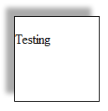
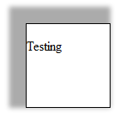
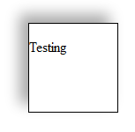
Box Shadow (CSS3)
.myItem { box-shadow: -2px 4px 5px #000000; }
Create a shadow around a box object
Horizontal Placement
Vertical Placement
Blur
Spread
Color
Spread = 10px
http://www.w3schools.com/cssref/

Slide 26
Text
Font Family
Font Size
Text Decoration
Font Style
Font Weight
Line Height
Letter Spacing
Word Spacing
Direction
Text Align
Text Indent
Text Outline
http://www.w3schools.com/cssref/

Slide 27
Font Family
.myItem { font-family: “arial”; }
Sets the font of the text. Can set to several values in case the web browser doesn't support one chosen.
Set by family-name or generic-name:
  “arial” is a family-name
  “sans-serif” is a generic-name
http://www.w3schools.com/cssref/

Slide 28
Font Family
.myItem { font-family: “arial”, sans-serif; }
Generic Names:
  serif, sans-serif, cursive, fantasy, monospace
Web-safe Fonts:
  Georgia, Times, Arial, Helvetica, Comic Sans (NO), Impact, Tahoma, Verdana, Courier New, Ludica Console
  More listed here:
  http://www.w3schools.com/cssref/css_websafe_fonts.asp
http://www.w3schools.com/cssref/
http://www.w3schools.com/cssref/css_websafe_fonts.asp

Slide 29
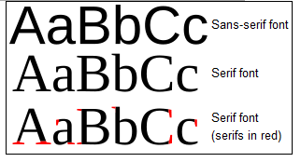
Font Family
.myItem { font-family: “arial”; }
Serif vs. Sans-Serif (From Wikipedia)
http://en.wikipedia.org/wiki/Sans-serif

Slide 30

Font Family
.myItem { font-family: “arial”; }
http://www.google.com/fonts
Has special fonts you can use on your webpage – gives you a .css file to link to and a family name to use.
<link href='http://fonts.googleapis.com/css?family=Kavoon' rel='stylesheet' type='text/css'>
font-family: 'Kavoon', cursive;

Slide 31
Font Size
.myItem { font-size: 20px; }
Set the font size
  Length in pixels (px), cm, …
  % - percent of parent's size
  small, medium, large, ...
http://www.w3schools.com/cssref/

Slide 32
Text Decoration
.myItem { text-decoration: underline; }
Various line properties
  none
  underline
  overline
  line-through
http://www.w3schools.com/cssref/

Slide 33
Font Style
.myItem { font-style: italic; }
Font styles:
  normal
  italic
  oblique
http://www.w3schools.com/cssref/

Slide 34
Font Weight
.myItem { font-weight: bold; }
Adds boldness
  normal
  bold
  older
  lighter
  100 – 900 (thin – thick)
http://www.w3schools.com/cssref/

Slide 35
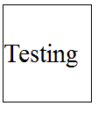
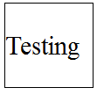
Line Height
.myItem { line-height: 20px; }
Sets the height of the line
  2 – will double the font-size
  2px – will be 2 pixels high
  2% - will be 2% of the current font size
http://www.w3schools.com/cssref/

Slide 36
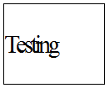
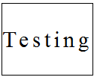
Letter Spacing
.myItem { letter-spacing: 5px; }
Sets the spacing between letters
  Specify either normal or a length in pixels/cm
  Negative values are allowed
http://www.w3schools.com/cssref/

Slide 37
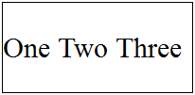
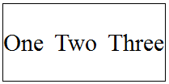
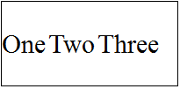
Word Spacing
.myItem { word-spacing: 5px; }
Set the spacing between words
  normal or length in px, cm, etc.
normal
5px
-5px
http://www.w3schools.com/cssref/

Slide 38
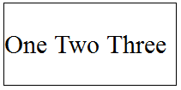
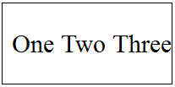
Direction
.myItem { direction: 5px; }
Set text-flow direction
  ltr – Left to right
  rtl – Right to left
http://www.w3schools.com/cssref/

Slide 39
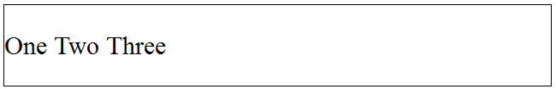
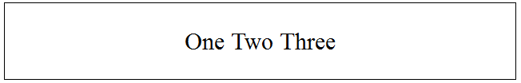
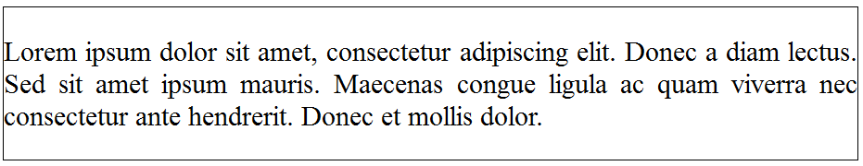
Text Align
.myItem { text-align: center; }
Set horizontal alignment
  left, right, center, justify
http://www.w3schools.com/cssref/

Slide 40
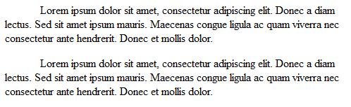
Text Indent
.myItem { text-indent: 50px; }
Affects amount of indent
http://www.w3schools.com/cssref/

Slide 41
Dimensions
.myItem { width: 100px; height: 50px; }
Set an object's width and height
.myItem { min-width: 100px; min-height: 50px; }
Set an object's minimum width/height
.myItem { max-width: 100px; max-height: 50px; }
Set an object's maximum width/height

Slide 42
Dimensions
Setting the width/height does not take into account padding or the borders – if you add these, your item's dimensions will increase!
Width can be % (relative to its parent), a length in px, cm, or set to auto.

Slide 43
Dimensions
Different elements have different display types and may not be affected.
For example, using the width style on a span tag <span>
  Unless you change the display of the span tag, width won't do anything.

Slide 44
Types of Display
Elements have different categories they fit in for how they behave:
none – does not display
inline – does not have its own line by default (no line-breaks before or after)
block – does not allow elements next to it.
There are more types, but these are the main ones. http://www.w3schools.com/cssref/pr_class_display.asp
http://www.w3schools.com/cssref/pr_class_display.asp

Slide 45
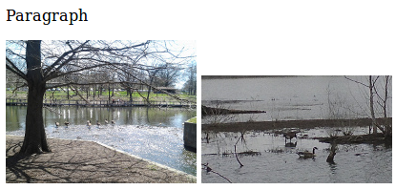
Display
.myItem { display: block; }
Set the display of an element
Paragraph wants its own line, but two images sit next to each other if we don't add line breaks (<br/>).

Slide 46
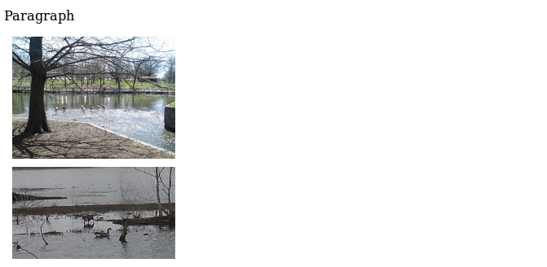
Display
Say that we want to center an image on the page.
  First we need to set the display to block.

Slide 47
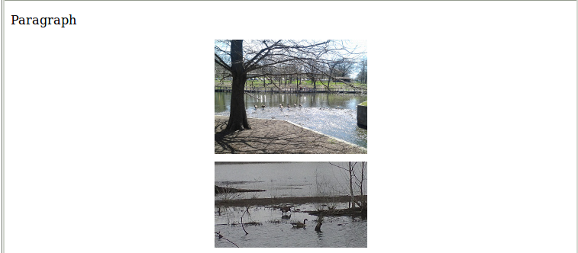
Display
Then we need to set the margins (we haven't gone over this yet).

Slide 48
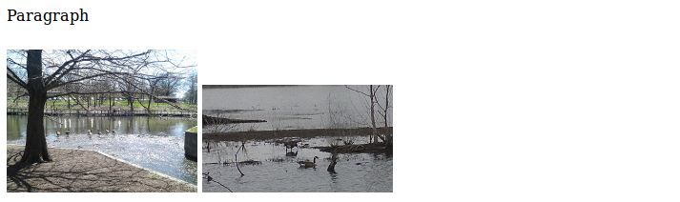
Display
Without setting display: block, it wouldn't work!

Slide 49
Layout
Margins
Padding
Float
Clear
Position
Top, Left, Bottom, Right
Z-Index

Slide 50
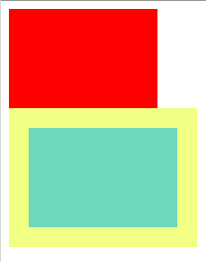
Margins
Margins affect the area outside of an element.
The margin doesn't affect the element's internal size.
The yellow here shows the margin

Slide 51
Margins
You can set every direction at once, vertical and horizontal separately, or top/right/bottom/left in one.
.myItem { margin: 20px; }
.myItem { margin: 20px 10px; }
.myItem { margin: 2px 3px 4px 5px; }
All directions
Vertical is 20, Horizontal is 10
Top is 2, right is 3, bottom is 4, and left is 5

Slide 52
Margins
You can also set them separately
.myItem { margin-left: 20px; }
.myItem { margin-right: 20px; }
.myItem { margin-top: 20px; }
.myItem { margin-bottom: 20px; }

Slide 53
Margins
Margins can be:
  Length (px, cm, etc.)
  Percent, with respect to parent element
  Auto, automatically places it.
If you set left and right margins to auto, and your element has a block display, it will be centered on the page!
I know we all miss the <center> tag, but it's deprecated now so don't use it!

Slide 54

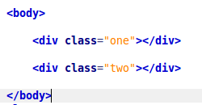
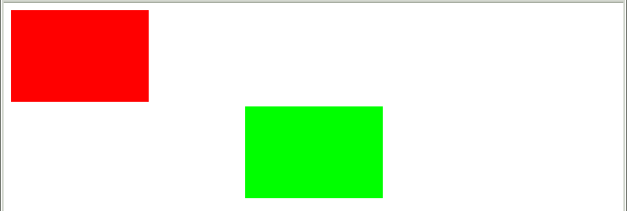
Margins
Centering an element:
Set the CSS
Result

Slide 55
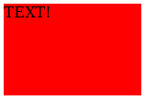
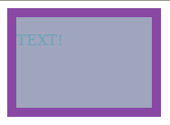
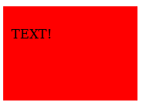
Padding
Padding affects the inside of your element, and adds spacing.
This will affect the width of your element, so beware on pages with very exact positioning!
No padding
Padding – box is bigger, text doesn't stick to the corner
The border is the padding here.

Slide 56
Clear
You can use the Clear style to enforce no elements are neighboring in a certain direction...
  clear: left;
  clear: right;
  clear: both;
  clear: none;

Slide 57
Float
Float allows you to stick an object to the left or right side.
This also makes them stack against each other horizontally.
This can cause rendering problems on your webpage! This is why “clearfix” exists!

Slide 58

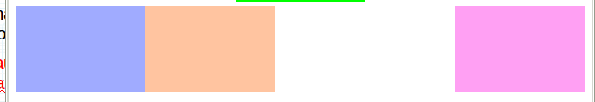
Float
Floats are really useful:

Slide 59
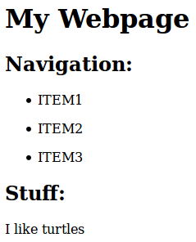
Float
But can cause problems:
Gee this page is swell. But the navigation takes up a lot of vertical space. Let's make those List Items float left!

Slide 60
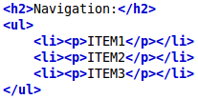
Float
But can cause problems:
Now I should have a nice, horizontal nav bar!

Slide 61
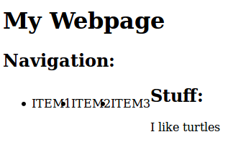
Float
But can cause problems:
What the heck?!
Our floating List Items are contained within an Unordered List, but mess up the markup position coming afterwards!

Slide 62

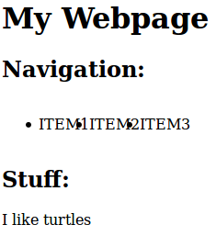
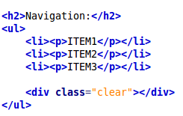
Float Fix #1
Fix #1: create a “clear” class:
Now it's OK
Add an element with the “clear” class after any floating items.

Slide 63
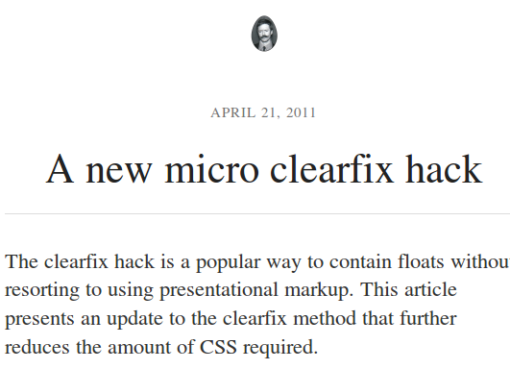
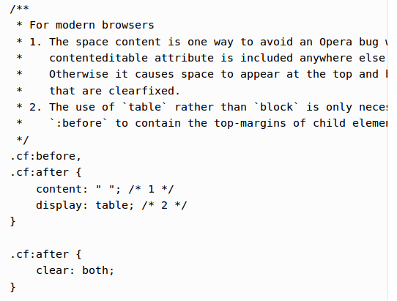
Float Fix #2
Fix #2: Google “clearfix”
Put the code into your CSS file
http://nicolasgallagher.com/micro-clearfix-hack/

Slide 64
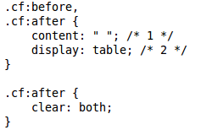
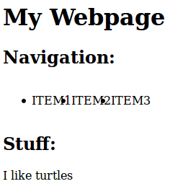
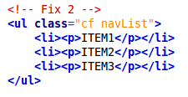
Float Fix #2
Fix #2: Google “clearfix”
Add the Clearfix CSS
Add the “cf” class to the Container Element

Slide 65
Position
Elements can be positioned according to different rules:
  Static (default)
  Absolute
  Fixed
  Relative

Slide 66
Position
If you need to review in the future, this tutorial is really helpful:
http://www.barelyfitz.com/screencast/html-training/css/positioning/

Slide 67
Position
.myItem { position: static; }
Static Positioning
  Elements are rendered in order of the markup.
http://www.w3schools.com/cssref/

Slide 68
Position
.myItem { position: absolute; }
Absolute Positioning
  Elements are rendered at your specified coordinates relative to any non-static parents.
  Specify left, right, top, or bottom to position.
http://www.w3schools.com/cssref/

Slide 69
Position
.myItem { position: fixed; }
Fixed Positioning
  Position is fixed at the same position, no matter the scrolling.
  Is with respect to the browser window.
http://www.w3schools.com/cssref/

Slide 70
Position
.myItem { position: relative; }
Relative Positioning
  The element is positioned relative to its default position.
  Can specify left, right, top, or bottom.
  So new position would be
  x_default + left
http://www.w3schools.com/cssref/

Slide 71
Top, Left, Bottom, Right
Specify locations for non-static elements.
.myItem { top: 5px; }
.myItem { bottom: 5px; }
.myItem { left: 5px; }
.myItem { right: 5px; }

Slide 72
Z-Index
Z-index allows you to specify which elements are ahead of or behind others.
It is the “Z-axis”.
  But this is index, so you only specify an ordering number.
  The higher the number, the more on-top it is.
.myItem { z-index: 3; }
http://www.w3schools.com/cssref/

Slide 73
List Style
You can remove or changed the bulleted list appearance with list-style.
  list-style-type
    Circle, square, katakana
    View full list here:
    http://www.w3schools.com/cssref/pr_list-style-type.asp
  list-style-position
    inside or outside, based on the margin
  list-style-image
    Specify a url for the list bullets.
http://www.w3schools.com/cssref/

Slide 74
List Style
Can set multiple items with just list-style
.myItem { list-style: url( "bullet" ) inside; }

Slide 75
Cursor
.myItem { cursor: pointer; }
Can change what the mouse looks like when it hovers over the element.
  Auto (default)
  Crosshair
  Pointer
  Wait
  See full list here:
  http://www.w3schools.com/cssref/pr_class_cursor.asp
http://www.w3schools.com/cssref/

Slide 76
Overflow
.myItem { overflow: hidden; }
When you have a container element that is a fixed size, text within may overflow.
You can specify whether to allow it to scroll horizontally, vertically, both, or just hide any overflowing data.
http://www.w3schools.com/cssref/

Slide 77
Overflow
.myItem { overflow: hidden; }
There is overflow, overflow-x, and overflow-y.
They can have the values:
  visible (not clipped, renders outside the box)
  hidden (clipped)
  scroll
  auto (only add scrollbar on overflow)
http://www.w3schools.com/cssref/

Slide 78
Overflow
.myItem { overflow: hidden; }
.myItem { overflow-x: visible; }
.myItem { overflow-y: auto; }
http://www.w3schools.com/cssref/

Slide 79
References
CSS Reference, W3Schools.com
http://www.w3schools.com/cssref/
Sans-serif, Wikipedia.org
http://en.wikipedia.org/wiki/Sans-serif

